Slide 1
COMP 1001: Introduction to Computers for Arts and Social Sciences

Slide 2
Introduction to Computer Science and This Class
Monday, May 9, 2011

Slide 3
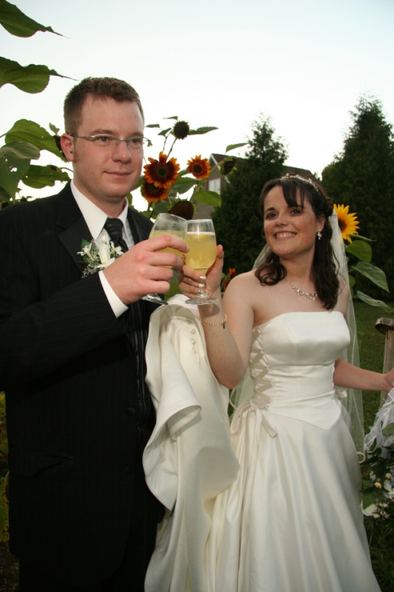

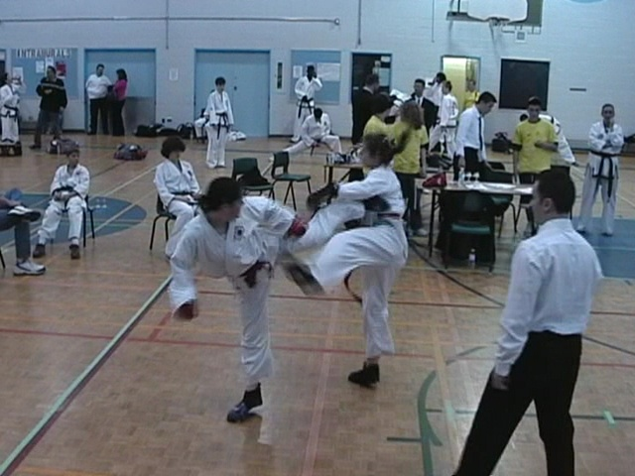
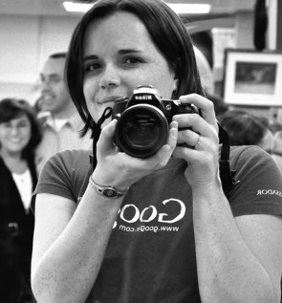

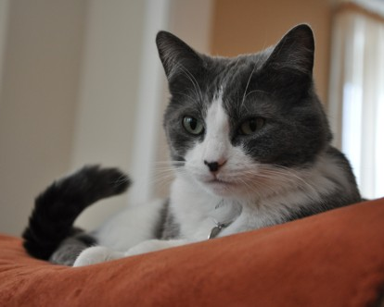
About Me

Slide 4

About Me
Bachelor of Computer Science (2002-2007)
Masters of Computer Science (2007-2009)
PhD Computer Science (2009-now)

Slide 5

Did you say computer science?!
http://www.flickr.com/photos/andresthor/3963368371/
Notes:
This class is meant for everybody.
No prior experience is needed.
If you have never used a computer before, don’t be embarrassed.
Check out the detailed how-to slides and tutorials on WebCT and please please please come to office hours if you need any help at all.

Slide 6
Gain an appreciation of computer science.
Notes:
The first objective of this course is to see what computer science is and hopefully learn to appreciate it.
Nobody expects you to switch majors, but it’s important to understand how computer science can help you.
For instance, there may be opportunities to work with someone from computer science on an interdisciplinary project!

Slide 7
Practice computational thinking.
Notes:
The next objective is to practice computational thinking.
This just means thinking logically, or in a concrete, step-by-step way.
University is a place of higher learning, and I believe that learning to think in different ways is important!
That’s why I took arts classes with lots of writing opportunities in my undergrad. ;)
Learning a simple programming language like Scratch will help exercise other parts of our brain.

Slide 8
Learn useful software.
Notes:
The last objective is what this course has typically covered in the past.
The aim is to expose you to as many useful computer tools as possible.
Ranging from online stuff to free and commercial software to install on your computer.

Slide 9
Our Topics
Introduction to computer science and computational thinking
Introduction to Microsoft Word
Basic programming with Scratch
Binary numbers and data representation
Algorithms

Slide 10
Our Topics
Introduction to Microsoft Excel (including relation to algorithms)
Human-computer interaction / human factors
Introduction to Microsoft PowerPoint
Using the Internet effectively: useful software and tools
Open source software

Slide 11
This course is NOT about programming industry languages (that’s COMP 1005/1405).
Notes:
Believe it or not, one person last year was very disappointed that we did not learn to program a “real” language.
If that’s what you are looking for, I want you to know right away that this is not the right course.
In fact, there is more technical content in my version of the course than any other – during the year you typically just learn how to use software (which isn’t actually computer science at all).

Slide 12
http://www.scs.carleton.ca/courses
http://webct.carleton.ca
Notes:
The School of Computer Science (SCS) course page is a good place to go if you want to quickly find the outline
The course will be completely contained in WebCT though, and the link to the course webpage just goes there
(Give quick tour of WebCT in class)

Slide 13
Component | Weight
Assignment 1: Software tutorial | 10%
Assignment 2: Programming in Scratch | 10%
Assignment 3: Binary, data, algorithms | 10%
Assignment 4: Human-computer interaction | 10%
In-class quizzes: 5 at 5% each | 25%
Final Exam | 35%

Slide 14
Labs
3115 HP and 3341 HP
http://www.scs.carleton.ca/nethelp/
All software available
TA Office Hours in 3341 HP
Notes:
Create an account once you get to the lab
All required software should be available, but let me know if it’s not

Slide 15
Policies
Come to class.
Participate.
Submit on time.
Take advantage of office hours.
Notes:
The goal is to make this an interactive class. As such, it will be difficult to understand the concepts if you don’t attend class.
Remember, each class you miss is like missing two in a row during the rest of the year!
The quizzes and exam will be based on evaluating how well you understand the concepts discussed in class.
It will NOT test your ability to memorize.
This is another reason to come to class and to participate when given the opportunity.
If you do miss a class, don’t panic – take advantage of me and the TA’s by attending our office hours.

Slide 16
Resources
First Year Experience Office
Student Academic Success Centre
Writing Tutorial Services
Research Help at the Library

Slide 17

So what exactly is computer science anyway?
http://www.stu.edu/images/sciencetechnology/new/biopic6.jpg

Slide 18
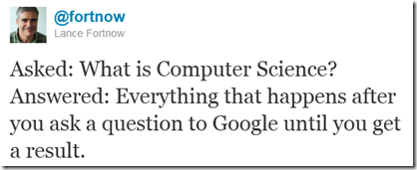
Notes:
Image copied from this blog post on “What Is Computer Science All About”
http://blogs.msdn.com/b/alfredth/archive/2011/03/10/what-is-computer-science-all-about.aspx

Slide 19
What is computer science?
Discuss what you think computer science is with a partner.
Exchange your ideas with another pair.
A few volunteers will write their definition(s) on the board.

Slide 20
What is computer science?
The big fancy definition:
Computer science (or computing science) is the study of the theoretical foundations of information and computation and their implementation and application in computer systems.
http://en.wikpedia.org/wiki/Computer_science

Slide 21
What is computer science?
It’s all about finding ways to figure stuff out.
What can be computed automatically?
How hard is it to compute?
What cool applications are there? (Like video games, Facebook, and more)
What’s the best way to set up a computer so it can do all this stuff fast?

Slide 22
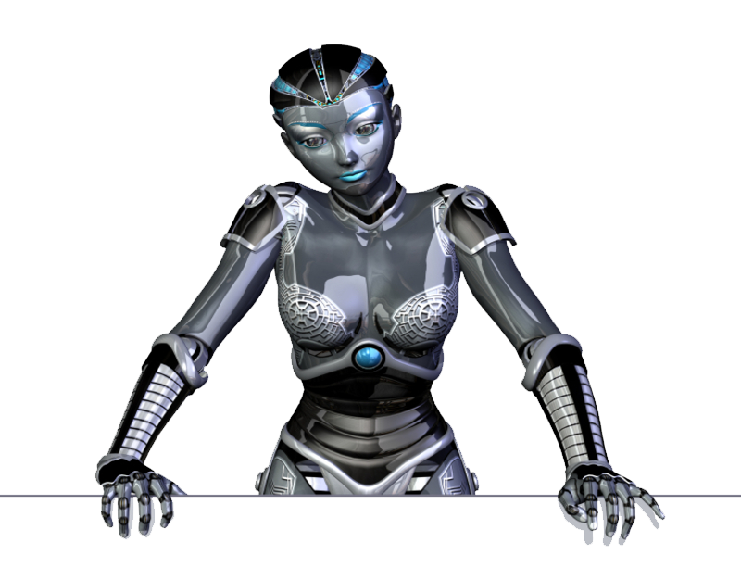
Computer science goes well with…
http://www.dailygalaxy.com/photos/uncategorized/2007/10/30/robot_5.jpg

Slide 23
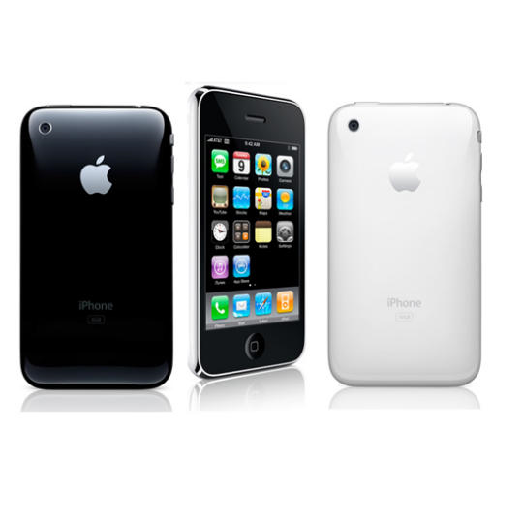
Computer science goes well with…
http://news.cnet.com/i/bto/20080609/iphone_550x550_540x539.jpg

Slide 24

Computer science goes well with…
http://www.waynepubliclibrary.org/images/music%20notes.JPG

Slide 25
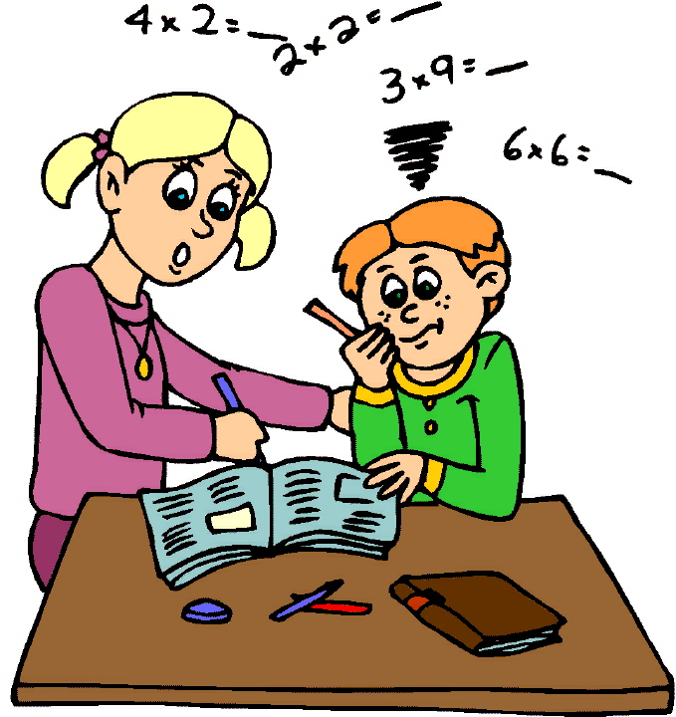
Computer science goes well with…
http://www.math.msu.edu/~mshapiro/kidmath_files/mathematics.jpg

Slide 26
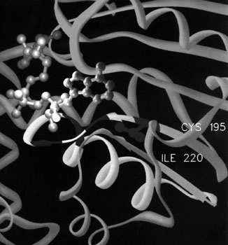
Computer science goes well with…
http://www.wadsworth.org/cores/images/stats.jpg

Slide 27
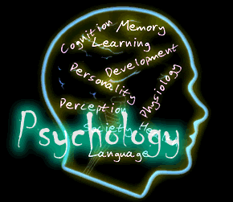
Computer science goes well with…
http://departments.weber.edu/psychology/Psychology.gif

Slide 28

Computer science goes well with…
http://images.pearsoned-ema.com/jpeg/large/9780130461094.jpg

Slide 29

Computer science goes well with…
http://hornbillunleashed.files.wordpress.com/2009/10/law.jpg

Slide 30

Notes:
Pathways in Computer Science video from University of Washington Computer Science and Engineering
http://www.cs.washington.edu/whyCSE

Slide 31
1% Bonus Opportunity
Present a one-page mini-tutorial on MS Word this Wednesday
Get 1% bonus on your final grade
See me during the break to get your sheet (write your name and student number on it and give it to me after you present)

Slide 32

Computational Thinking
http://www.isgtw.org/announcement/isgtw-announcement-call-applications-cyber-enabled-discovery-and-innovation-program

Slide 33
Computational Thinking
“Computational thinking enables you to bend computation to your needs. It is becoming the new literacy of the 21st century.”
Notes:
Quote directly taken from
http://computinged.wordpress.com/2011/03/22/a-definition-of-computational-thinking-from-jeanette-wing/
And originally comes from
http://link.cs.cmu.edu/article.php?a=600
Check out both links to get a better feel for the concept.

Slide 34
Computational Thinking
“Informally we might define CT as a set of thinking or problem-solving strategies that are used to solve problems when working with computers, and that can also be applied to many problem types, even absent the computer.”
Notes:
This and the following quotes from this computer science teacher’s association newsletter
http://csta.acm.org/Communications/sub/CSTAVoice_Files/csta_voice_05_2011.pdf
There are several good articles discussing the concept

Slide 35
Computational Thinking Characteristics
“Formulating problems in a way that
enables us to use a computer and other
tools to help solve them.”

Slide 36
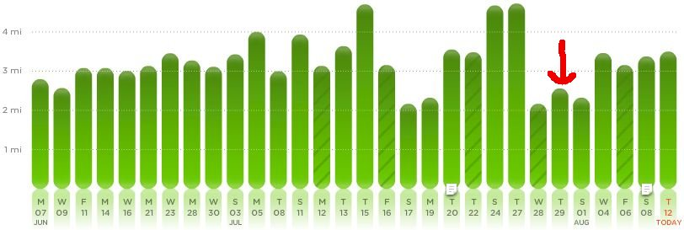
Computational Thinking Characteristics
“Logically organizing and analyzing data”
http://computinged.wordpress.com/2010/08/12/go-to-the-data-two-stories-of-really-computational-thinking/

Slide 37
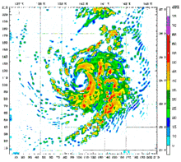
Computational Thinking Characteristics
“Representing data through abstractions
such as models and simulations”
http://en.wikipedia.org/wiki/Computer_simulation

Slide 38
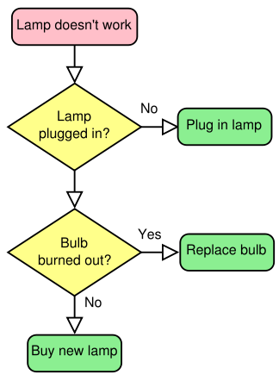
Computational Thinking Characteristics
“Automating solutions through algorithmic thinking (a series of ordered steps)”
http://www.dicts.info/picture-dictionary.php?w=algorithm

Slide 39
Computational Thinking Characteristics
“Identifying, analyzing, and implementing possible solutions with the goal of achieving the most efficient and effective combination of steps and resources”

Slide 40
Computational Thinking Characteristics
“Generalizing and transferring this problem solving process to a wide variety of problems”

Slide 41
Benefits of Being Able to Think Computationally
“Confidence in dealing with complexity”

Slide 42
Benefits of Being Able to Think Computationally
“Persistence in working with difficult
problems”

Slide 43
Benefits of Being Able to Think Computationally
“Tolerance for ambiguity”

Slide 44
Benefits of Being Able to Think Computationally
“The ability to deal with open-ended
problems”

Slide 45
Benefits of Being Able to Think Computationally
“The ability to communicate and work
with others to achieve a common goal
or solution”

Slide 46
Where can you (or where do you already) use computational thinking in your field?
Brainstorm in pairs, share with class

Slide 47
How Will We Learn Computational Thinking?
Learning basic programming principles in Scratch
Understanding a small selection of algorithms
Applying algorithmic thinking to more advanced features of Excel
Seeing how computers represent data

